Slide 1
CEPA
The Continental Energy Programme in Africa

Slide 2


Africa’s energy paradox
Rich resources, limited access.
Photo: Luke Barky, Pexels.

Slide 3

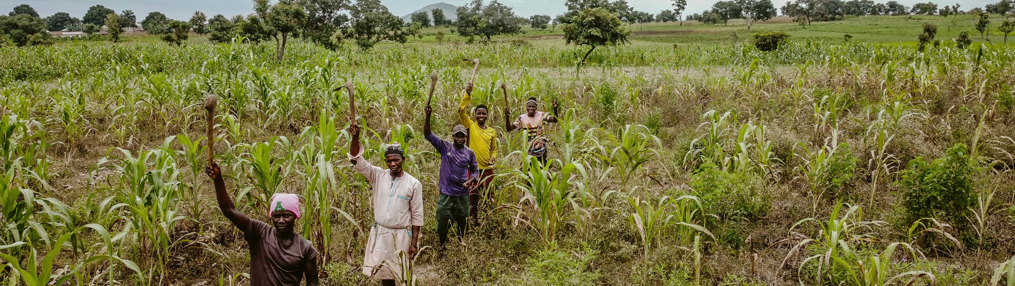
Photo: Alex Gamaliel, Pexels.
600 million people in Africa still lack access to electricity (IEA, 2022) – that’s 43% of the population, primarily in rural areas.
Almost 1 billion people lack access to clean cooking, contributing to deforestation and health issues.
Electricity consumption and GDP per capita remain far below global averages (less than 3,000 kWh annually and $12,000 GDP/capita).

Slide 4



Despite this, Africa holds immense renewable energy potential
Hydro
287 GW enough to cover 70% of projected peak demand by 2040
Solar and wind
7,500 GW 18 times projected demand by 2040
Source: IEA Energy Outlook ‘Africa is rich in energy resources, yet home to most of the world’s energy-poor people’.

Slide 5





Why now?
What are the opportunities?
Electricity demand in Africa to triple by 2040
Generation capacity needs to rise from 266 GW (2023) → 1,218 GW by 2040
Green energy share expected to rise from 24.6% → 63.8% by 2040
Requires ~$1.29 trillion in investments
The supports this shift

Slide 6
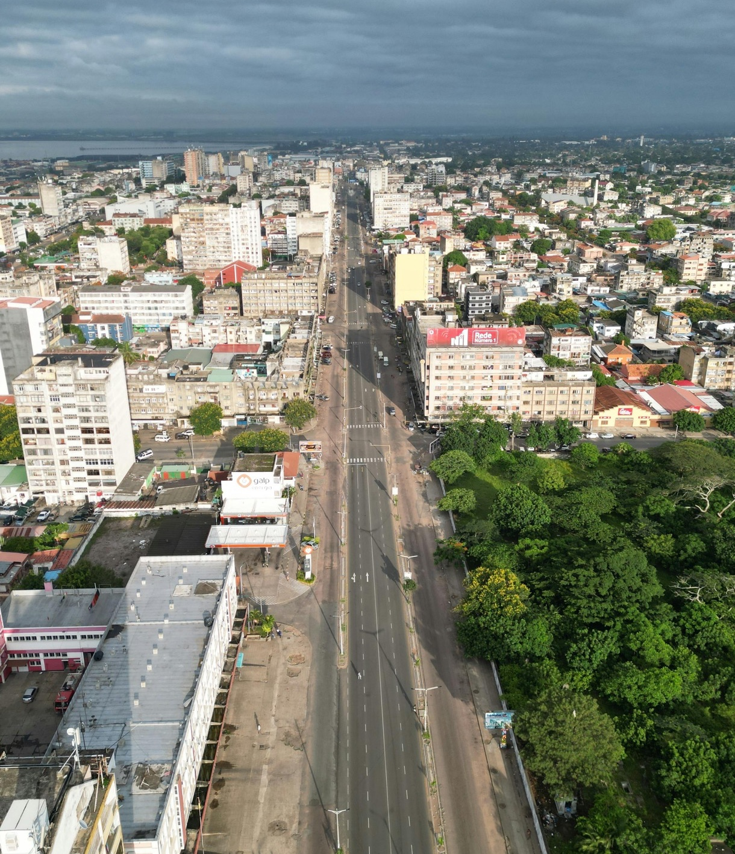
The transformational opportunity for Africa’s energy future.
Photo: SINAL Multimédia, Pexels.

Slide 7

CEPA supports a just and inclusive energy transition
Focus on building One Market, One Grid,
One Efficiency Framework
AfSEM (African Single Electricity Market) Enabling cross-border electricity trade and economies of scale.
CMP (Continental Power System Master Plan) Infrastructure blueprint for an interconnected Africa.
AfEES (Energy Efficiency Strategy) Increase energy productivity by 50% by 2050, reducing the need for massive new generation investment.
Photo: Nachelle Nocom, Pexels.

Slide 8


Africa’s energy transition is also a global opportunity
Potential for green electricity exports
to Europe and the Middle East.
Investment needs are huge – doubling current levels to meet climate and energy goals.
Participation in green hydrogen and critical minerals value chains.

Slide 9
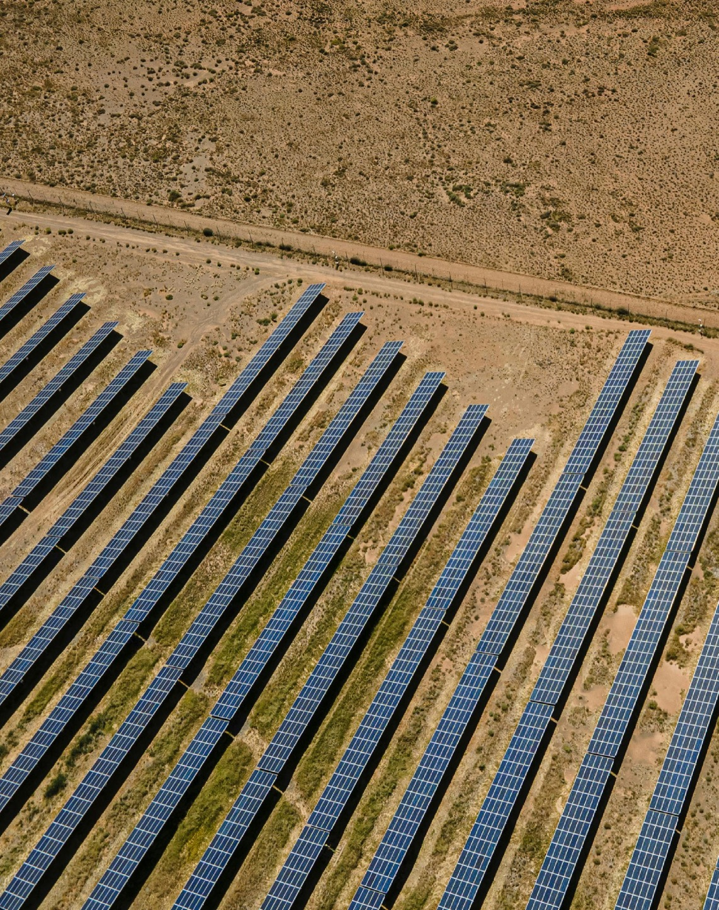
The expected benefits of AfSEM,
CMP and AfEES.
Photo: Charldurand, Pexels.

Slide 10
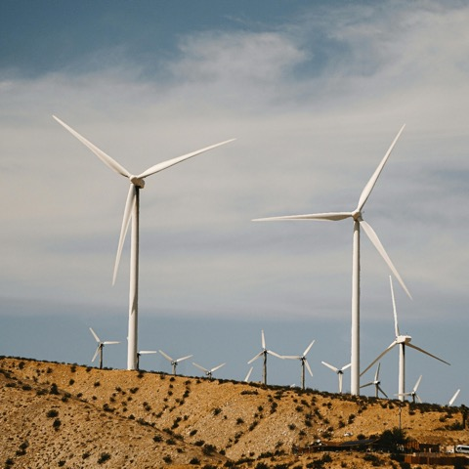




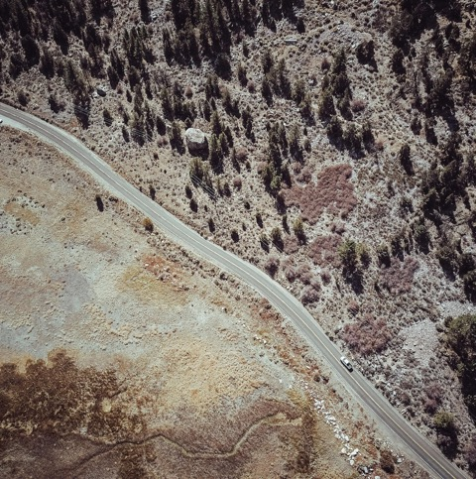



Enhanced energy access
Increased energy security and resilience
Market integration and investment opportunities
Technology transfer and expertise
Climate mitigation and adaptation
Economic growth and job creation
Pan-African cooperation and global Leadership
Photos: Kindel Media, Pexels.

Slide 11




The AfSEM African Single Electricity Market
Based on the African Continental Free Trade Area (AfCFTA)
Harmonises regulatory, legal
and technical frameworks
Mission statement
To create a single, unified electricity market that enhances access to reliable, affordable and sustainable electricity for all Africans by 2040.
Enables cross-border trade of electricity through power pools
A fully operational AfSEM will be the world’s largest electricity market, serving 1.3 billion people across 55 Member States of the African Union
Promotes energy security, economic growth and climate action

Slide 12





The CMP Continental Master Plan
Serves as the technical foundation
of AfSEM
Coordinates generation, transmission, and demand modelling across Africa
Mission statement
To design and develop the long-term infrastructure plan needed to implement the AfSEM by linking national and regional power systems.
Identifies priority corridors for energy investments (e.g. cross-border interconnectors)
The CMP is the blueprint that turns the vision of a unified electricity market into physical reality.
Supports policy harmonisation and system resilience
Enables intra- and intercontinental electricity trade

Slide 13
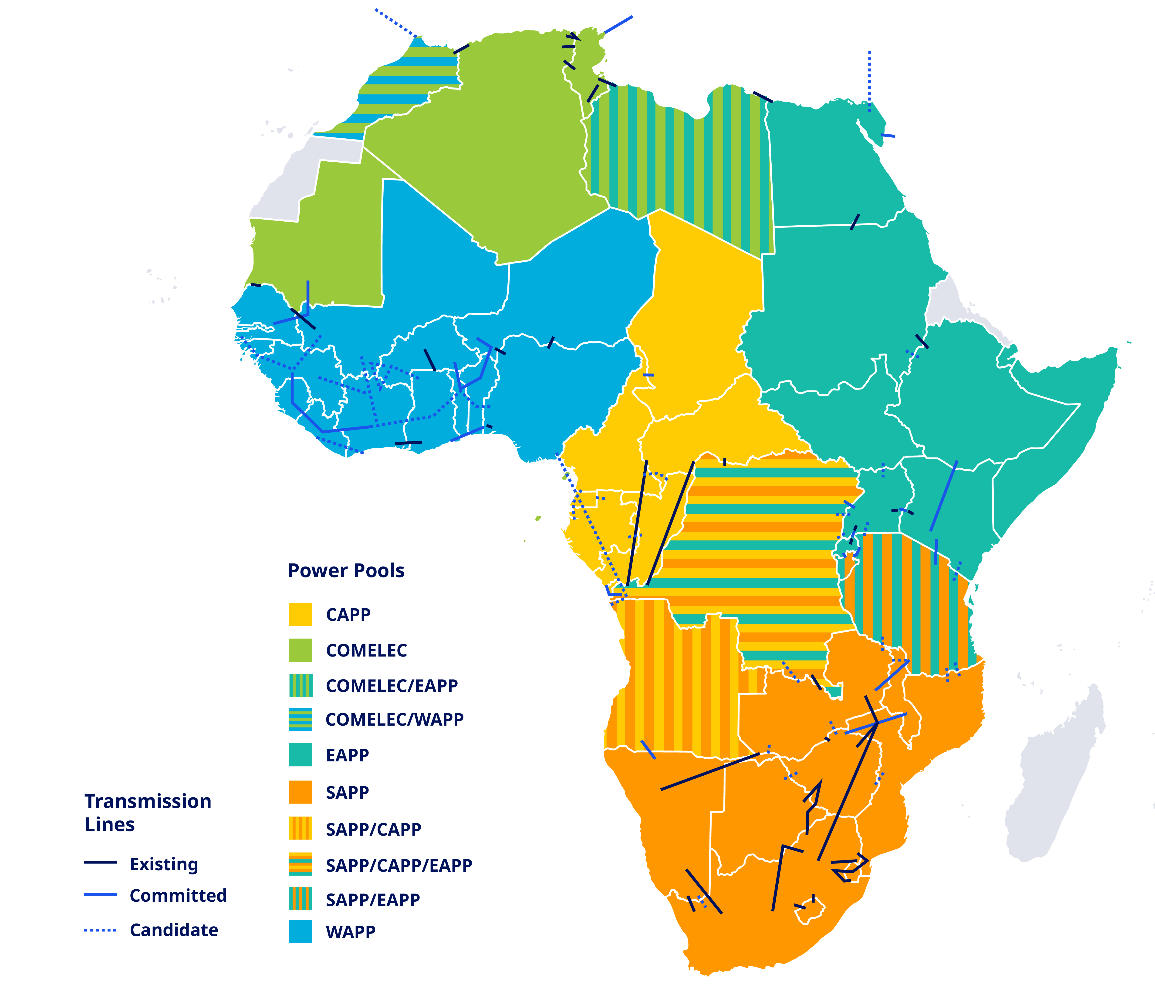
Transmission Interconnection Priorities of Power Pools by 2040

Slide 14
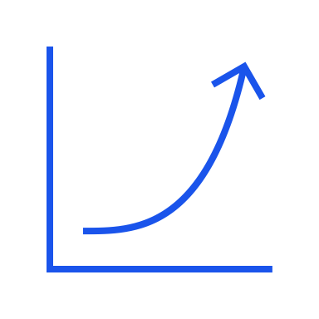




AfEES African Energy Efficiency Strategy
Targets a 50% increase in energy productivity by 2050
First AU-led strategy going beyond electricity to cover all energy sectors
Mission statement
To establish a sustainable, efficient and inclusive energy system that benefits both the environment and the economy while ensuring universal access to energy.
Structured around 6 sectoral roadmaps: industry, power sector, buildings, transport, agriculture and appliances
Helps decouple economic growth from energy consumption
AfEES is the demand-side engine that makes Africa’s green transition both affordable and achievable.
Supports climate goals, job creation, competitiveness and improved energy access

Slide 15
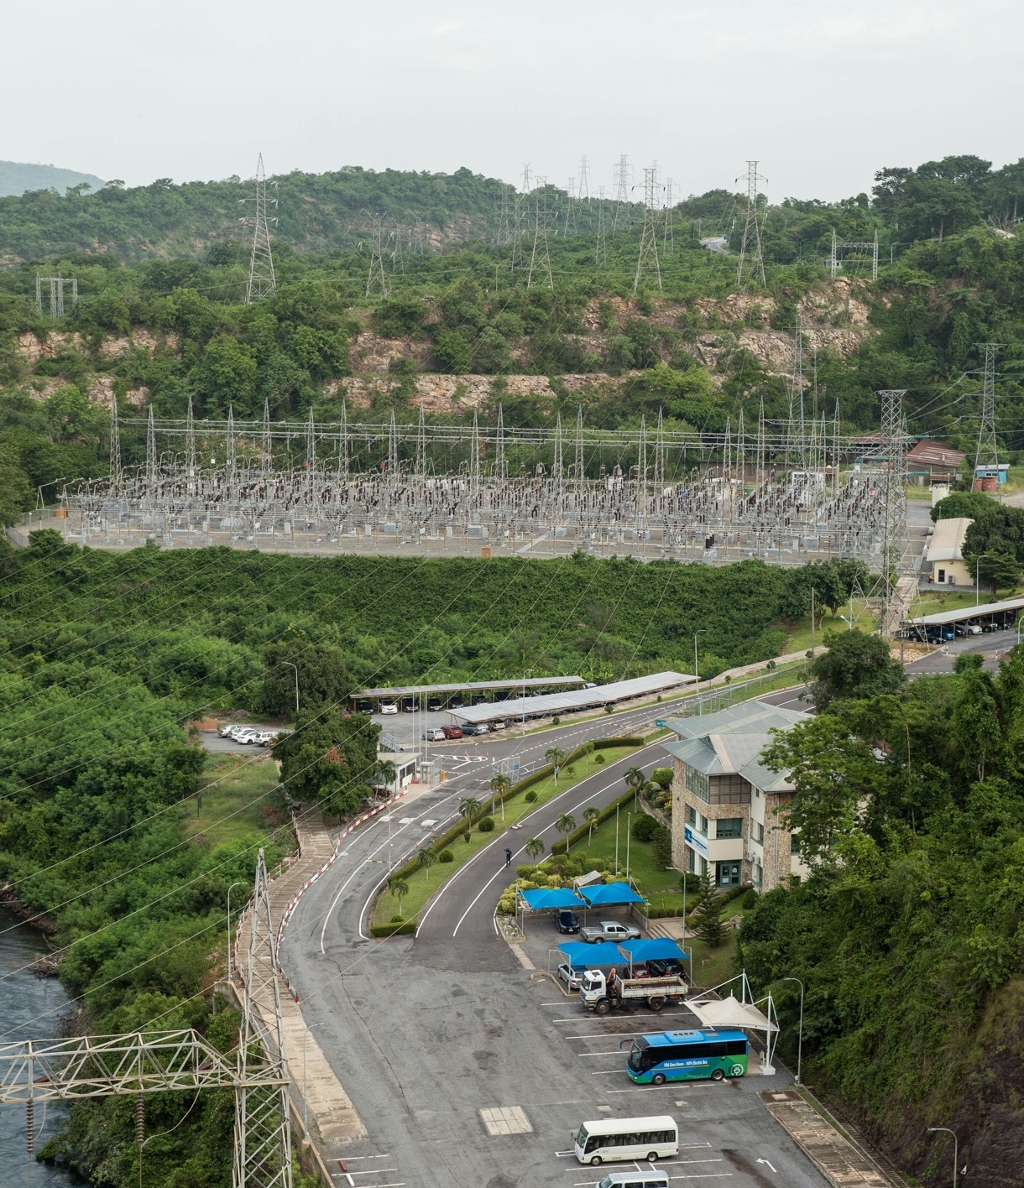
CEPA the cross-cutting support framework for Africa’s energy transition.
Photo: Andy Coffie, Pexels.

Slide 16





CEPA The Continental Energy Programme in Africa
Enable the AfSEM
Regulatory harmonisation and market access for cross-border trade and renewables
Operationalise the CMP
Prepare investments in RE generation, transmission and storage infrastructure
CEPA provides technical assistance, coordination support, and strategic communication for the implementation of the AfSEM, CMP, and AfEES under the leadership of the African Union Commission and its key institutions.
Implement AfEES
Policy reform, national/regional action plans, EE in all sectors
Objectives →
Ensure Institutional Coherence
Coordinate across RECs, Power Pools, donors, stakeholders

Slide 17
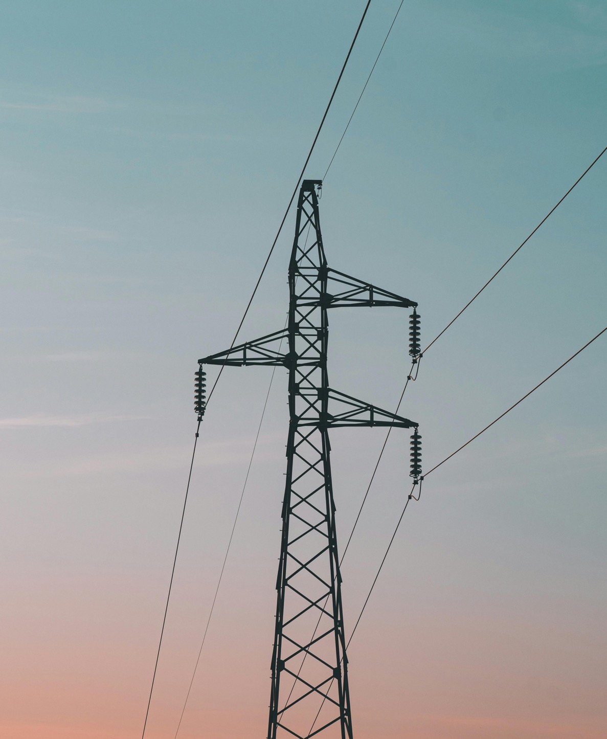
Achievements of the AfSEM, CMP and AfEES.
Photo: Mahmoud Yahyaoui, Pexels.

Slide 18

AfSEM
Key achievements
AfSEM officially launched in June 2021
Policy Paper and Roadmap validated by AU Member States (2021)
Five-Year Business Plan and Year-1 Work Plan adopted in 2023
Continental Tariff Calculation Tool developed and rolled out
Strategic Planning Process completed, including strategic objectives, evaluation mechanism and guidelines for operationalisation

Slide 19
What CEPA will deliver for AfSEM 2025-2028
Monitoring tools in place
Key actions under CEPA
CEPA will also support
AfSEM Online Monitoring Tool for implementation tracking
Operationalise the Single Project Coordination Unit (SPCU) at AUC-DIE
Regional regulatory harmonisation (tariff systems, licensing, interconnection codes)
AfDB’s Electricity Regulatory Index (ERI) (covers 43 AU Member States)
Stakeholder capacity building
and dialogue platforms
Establish and manage 5
Thematic Working Groups (Electricity Infrastructure, Regulation and Market Operation, Investment Coordination, Renewable Energy and Clean Energy Transition and Energy Efficiency)
Private sector and development finance institutions engagement
for market readiness
AFREC’s Africa Energy Statistics Database (AESD) to support data harmonisation
Public outreach and communications strategy for awareness and visibility

Slide 20

CMP
Key achievements
CMP development led by AUDA-NEPAD
Baseline Study completed in 2020
Continental generation and transmission modelling finalised
Synthesis report validated in September 2023
Endorsed by AU Assembly of the Heads of State and Government in February 2024

Slide 21
What CEPA will deliver for CMP 2025-2028
CMP as the technical backbone of AfSEM
Under CEPA, the CMP workstream will focus on
Strategic tools
to be refined
Ensures coordinated expansion of generation and transmission infrastructure
Finalising Ten-Year Transmission Network Development Plans (TYTNDPs) at national and regional levels
Forecasting tools and
geospatial models
Integration of renewable
energy variability
Preparing 20 pre-feasibility studies for priority transmission and renewable energy generation projects
Aligns with AU initiatives such as Green Mini-Grids Strategy, New Deal on Energy for Africa, Clean Energy Corridors or AfCFTA goals
Transmission corridor
planning platforms
Supporting investment identification and matchmaking with development finance institutions and private sector
Updating CMP planning methodology, incorporating off-grid electrification, productive energy uses, e-mobility and demand-side management

Slide 22

AfEES
Key achievements
AfEES Strategy Action Plan developed under AFREC and validated
6 sectoral roadmaps drafted (Industry, Power, Buildings, Transport, Agriculture, Appliances)
Development of Minimum Energy Performance Standards (MEPS) and labels in 36 countries
Establishment of Regional Centres for Renewable Energy and Energy Efficiency

Slide 23
What CEPA will deliver for AfEES 2025-2028
CEPA will support
CEPA will also help
Strategic focus areas
Development and roll-out of up to 10 National Energy Efficiency Action Plans (NEEAPs)
Enhancement of AFREC’s data collection on EE and development of indicators
Strengthening policy and institutional frameworks
Promoting technology adoption
and local innovation
Implementation of sectoral actions in all 6 roadmap areas
Create policy guidance tools
and model regulations
Engaging youth and women
in the EE value chain
Development of a continental roadmap for funding EE investments
Foster private sector investment in EE technology and services
Support regional harmonisation of EE standards and targets
Capacity building for national and regional stakeholders (incl. youth, local government, energy managers)
Translate continental energy productivity targets into sectoral targets
Promotion of RE-IPPs with EE-linked innovations (e.g. efficient cooling, productive uses)

Slide 24


How AfSEM, CMP and AfEES work together
Builds a
continental market
Regulatory harmonisation
Enables cross-
border trade
The AfSEM and its CMP component were endorsed as an Agenda 2063 flagship project at the 37th Ordinary Session of the AU’s Assembly of the Heads of State and Government, held in Addis Ababa in February 2024.
The combined and coordinated work on the AfSEM, CMP and now AfEES is the cornerstone of the new Africa-EU Green Energy Initiative (AEGEI) as part of the Global Gateway investment package.
AfEES
AfSEM
Drives energy efficiency
and demand management
Plans the infrastructure
to enable the market energy flows
Sectoral roadmaps
(e.g. buildings, transport)
CMP
Power system modelling
Reduces investment needs
via energy savings
Identifies generation and transmission priorities

Slide 25
Alignment with global and continental goals
Framework
Relevance
SDG 7 Affordable and Clean Energy
Universal access, efficiency, renewables
AU Agenda 2063
Integrated, prosperous and sustainable Africa
AU Climate Strategy
Climate-resilient development pathways
AfCFTA
Cross-border electricity as tradable good
Paris Agreement / NDCs
Mitigates emissions via green energy and efficiency
EU-AU Strategic Partnership
Supports AfSEM and CMP under energy cooperation
CEPA strengthens Africa’s leadership in clean energy and deepens Africa-Europe collaboration.

Slide 26

Governance and Implementation.
Photo: Silvere Meya, Pexels.

Slide 27
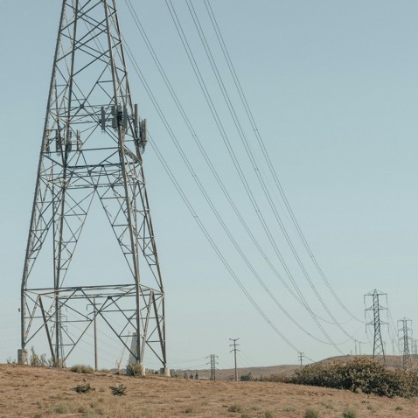

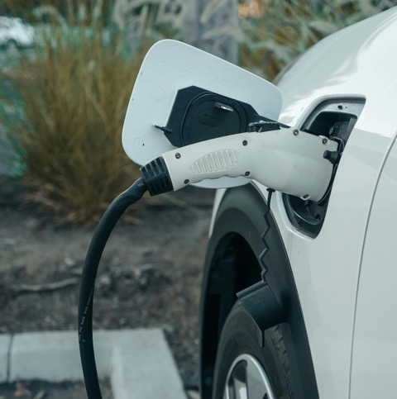


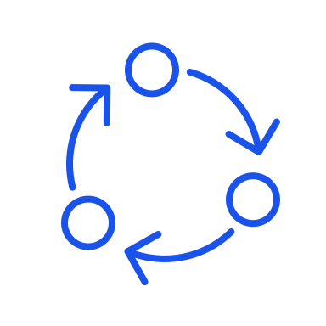
Key Institutions
AUC-DIE Strategic oversight, coordination, and monitoring of the AfSEM
AUDA-NEPAD Leads CMP technical development and infrastructure planning
AFREC Oversees AfEES and energy data systems
RECs and Power Pools (e.g. WAPP, SAPP, EAPP, CAPP) Implement market rules and regional coordination
Photos: Kindel Media, Pexels.

Slide 28
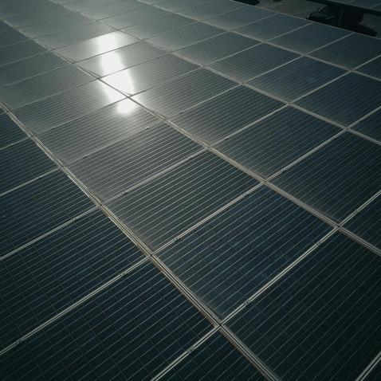
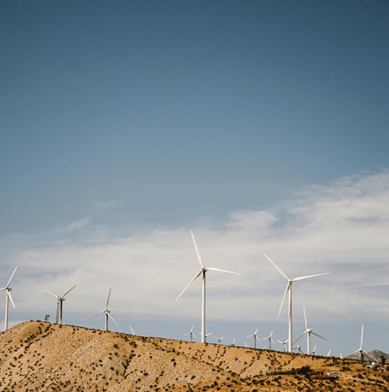
Implementation framework
SPCU – Single Project Coordination Unit hosted by AUC-DIE
Manages technical coordination, M&E
and stakeholder alignment
Oversees 5 working groups:
  Electricity infrastructure
  Regulation and market operation
  Investment coordination
  Renewable energy and climate mainstreaming
  Energy efficiency and energy transition
Photos: Kindel Media, Pexels.

Slide 29
Implementation Roadmap
2015
2019
2021
2023
2030
2040
Harmonisation
of Regulatory Frameworks for the Electricty Market
African Continental Master Plan
Launch of AfSEM
20-year Continental Master Plan
Universal Access to Electricity according to SDG7
Fully functional AfSEM
POLICY MILESTONES
PREPARATION, INST. STRENGTHENING, GOVERNANCE 2020-2025
ROADMAP
LAND & REGULATORY DEVELOMENT 2026-2030
MARKET OPENING 2031-2040

Slide 30
Implementation Roadmap
Short-term
2025 - 2026
Mid-term
2026 - 2027
Long-term
2027 - 2028+
CEPA launch and SPCU operational
Regional harmonisation pilot
in 10 countries (AfSEM)
Scale-up of electricity trade
Renewable energy manufacturing strategies (AfCFTA link)
Set up working groups (AfSEM)
Update of CMP 2026-2045 (including off-grid)
CMP pre-feasibility studies
Implement 10 AfEES National
Energy Efficiency Plans
CMP bankable projects mobilised
Start AfEES action plan implementation
Promote independent power producers of renewable energy, off-grid policy reform and carbon markets
Monitoring and evaluation systems running across all 3 initiatives
Develop communication, capacity building and
knowledge strategies

Slide 31
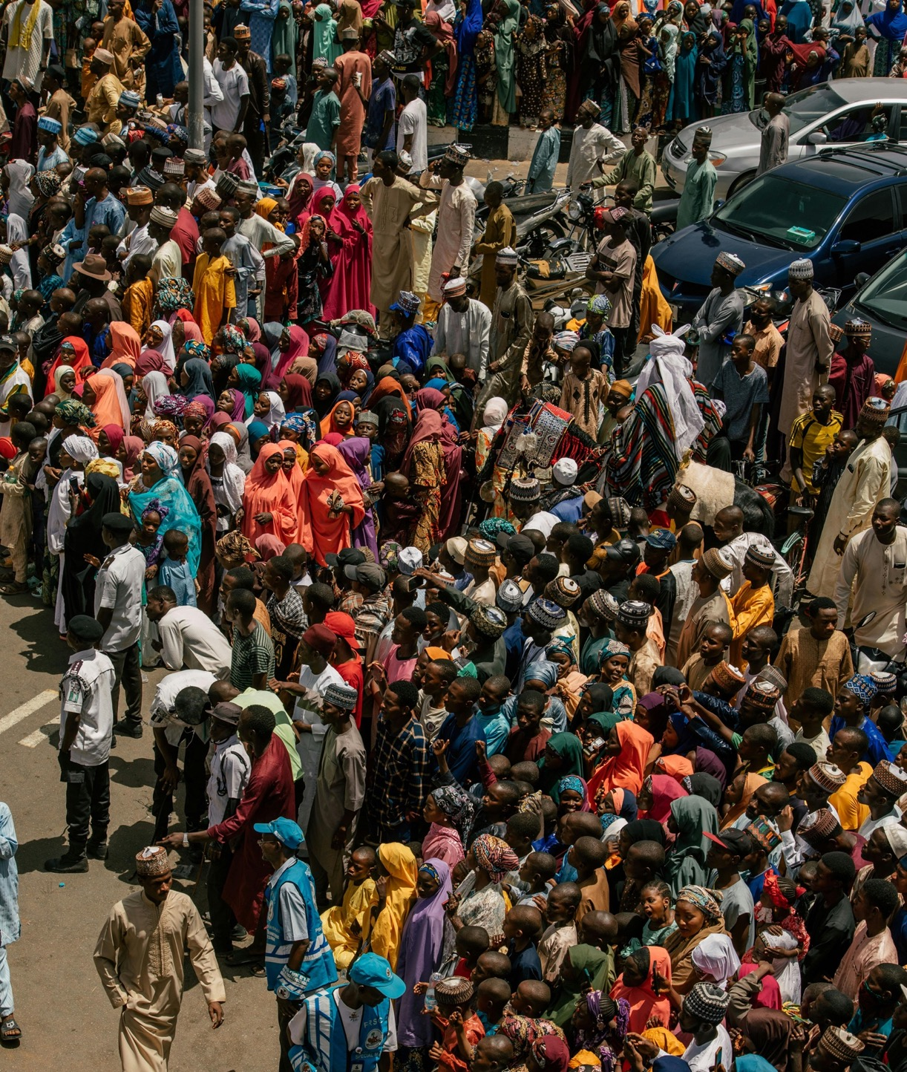
Together for Africa’s Just Energy Future
Photo: Al Ameen Saddiq, Pexels.

Slide 32






Key messages
Support implementation through technical and political engagement
Align national strategies and policies with continental frameworks
Africa’s energy transformation is a strategic opportunity
AfSEM, CMP and AfEES are Africa-led and globally aligned
CEPA is a bold step towards a greener, more integrated future
Invest in generation, transmission, and efficiency projects
Collaborate regionally to strengthen energy markets and institutions
Share knowledge, data and innovations to accelerate progress
Call to action for supporters →
Together, we can power Africa’s future – sustainably and inclusively.

Slide 42
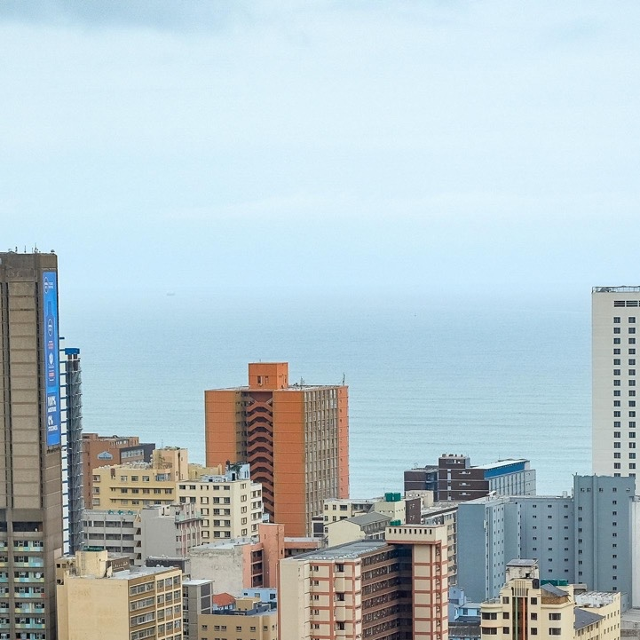

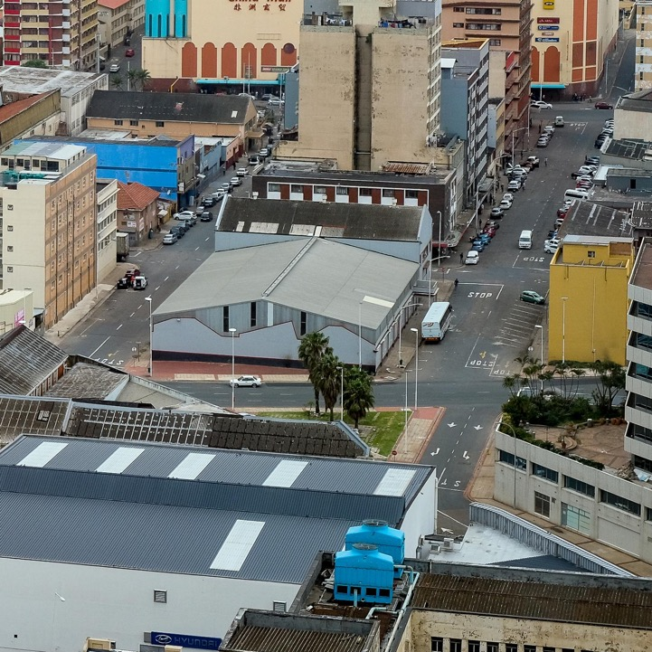
Contact
Name
Title
Email
Phone
Name
Title
Email
Phone
Photo: Magda Ehlers, Pexels.

